Slide 1

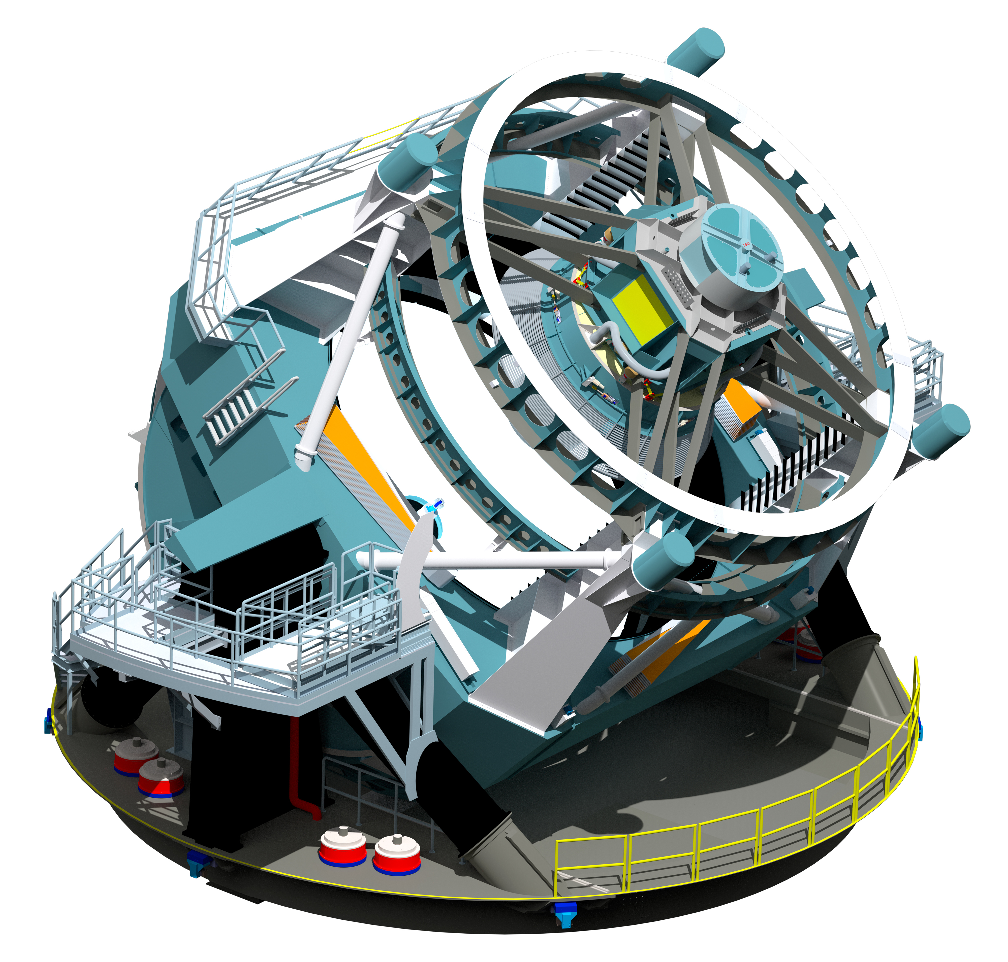
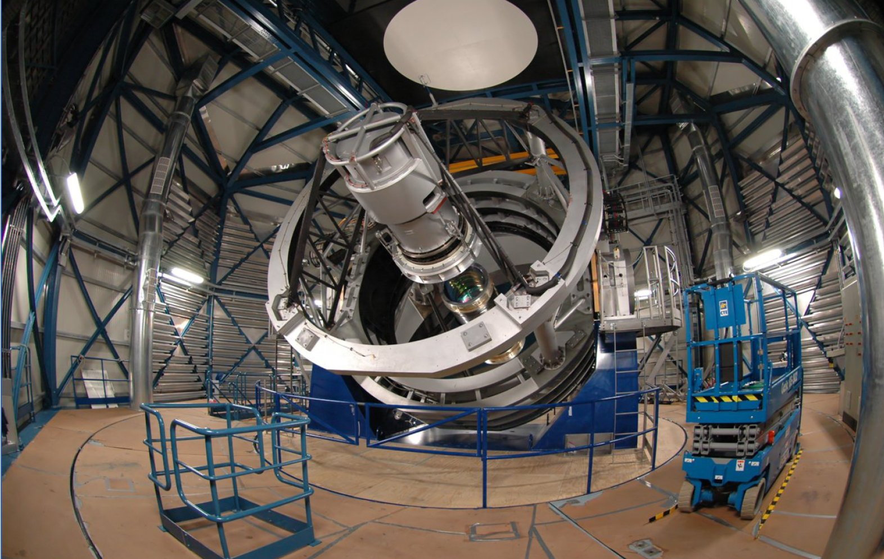

Spectroscopic Follow-up
Mark Sullivan, Southampton

Slide 2
Why do spectroscopy?
Why not?
Samples of 50,000 SNe easily within grasp
Systematics/biases in photometric-redshift cosmology unquantified
Spectroscopy provides reliable training samples
Enables ‘science’
Enables reliable environment studies

Slide 3
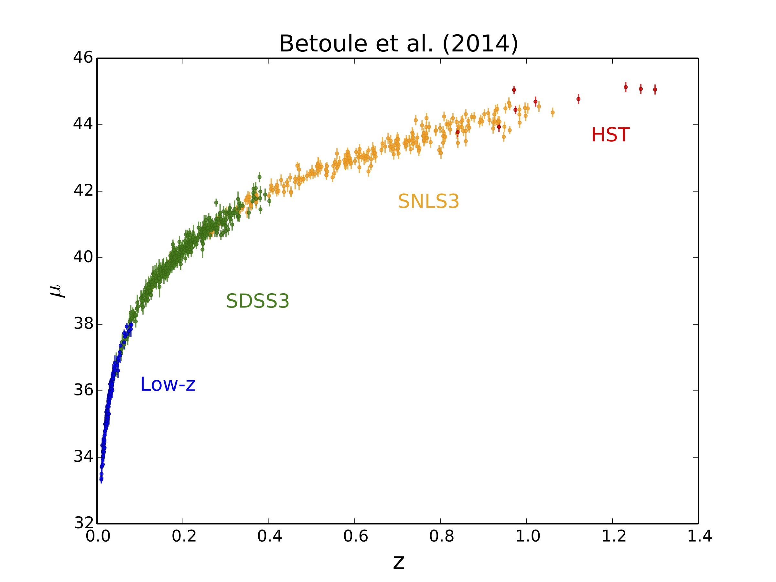
740 SNe Ia in JLA
Every SN Ia has both a spectroscopic type and a spectroscopic redshift

Slide 4
Simplified SN systematic-error budget (“JLA”)
Photometric calibration is (by far) the dominant systematic uncertainty
Betoule et al. 2014

Slide 5
Number of SNe discovered per year
The recent history of supernova discovery
>20,000 events discovered over 130 years
All SNe are spectroscopically confirmed
Accelerating universe discovered
First CCD searches
First robotic searches
Zwicky SN patrol
Term `super-nova’ coined
First extragalactic SNe

Slide 6
Number of SNe discovered per year
New low-z searches (PTF, PS-1)
LSST
High-z searches (SNLS, SDSS, ESSENCE)
DES
Calan/Tololo survey
LOSS
SCP and HZSST
~5 supernovae discovered and confirmed every day

Slide 7
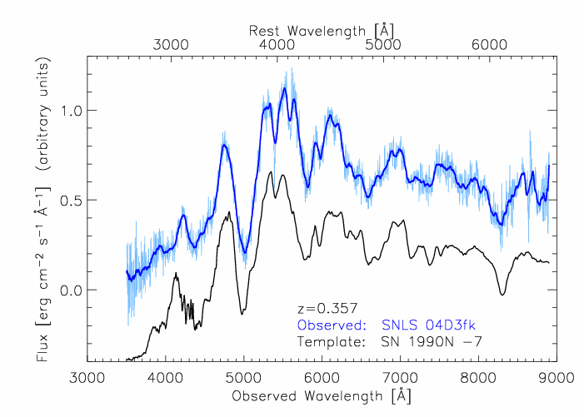
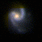
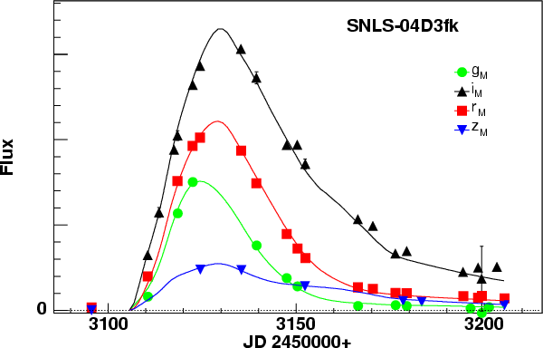
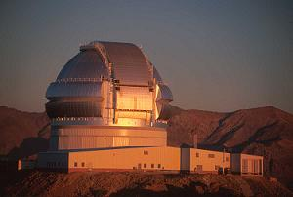
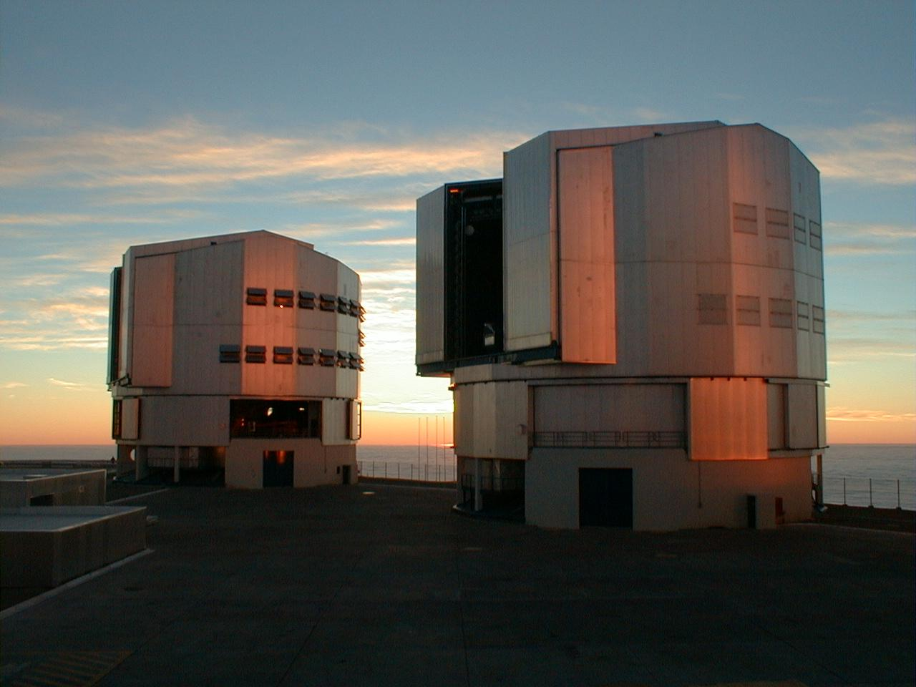
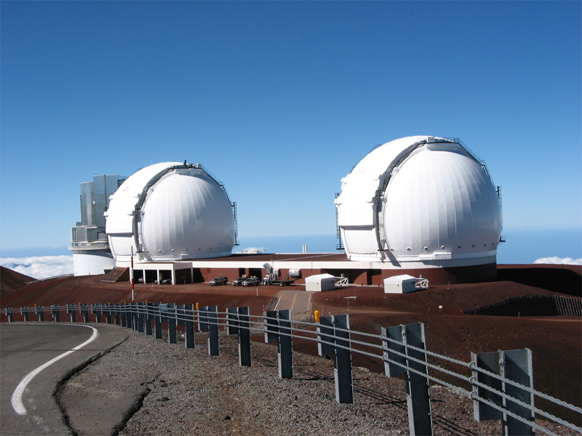
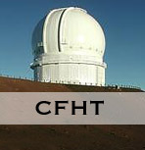
Supernova Legacy Survey: 2003—2008
Imaging
Distances from
light-curves
Spectroscopy
Redshifts ➔ Distances from cosmological model
Discoveries
Lightcurves
Gemini N & S (120 hr/yr)
VLT
(120 hr/yr)
Keck
(8 n/yr)
More 8m-class telescope time (~1600h) than CFHT time (~1200h)
Led to ~750 spectra
~440 SNe Ia
g’r’i’z’ every 4 days during dark time

Slide 8
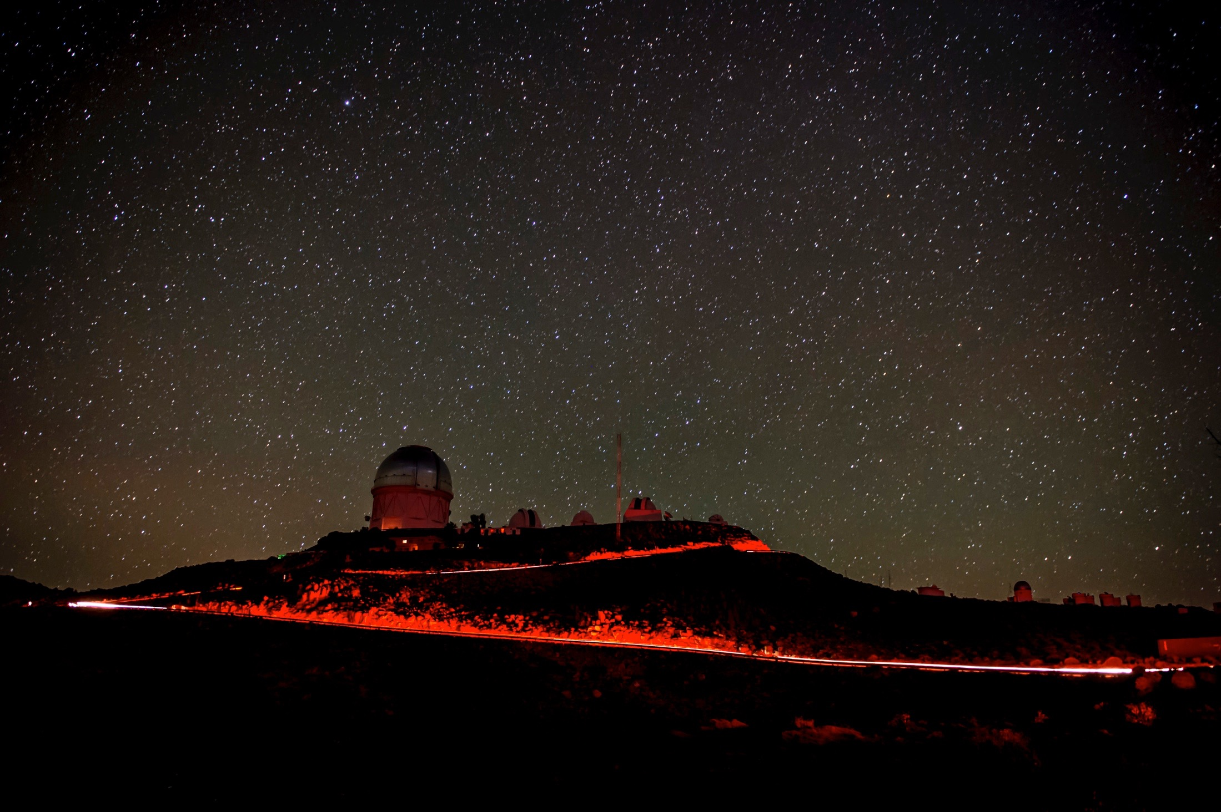
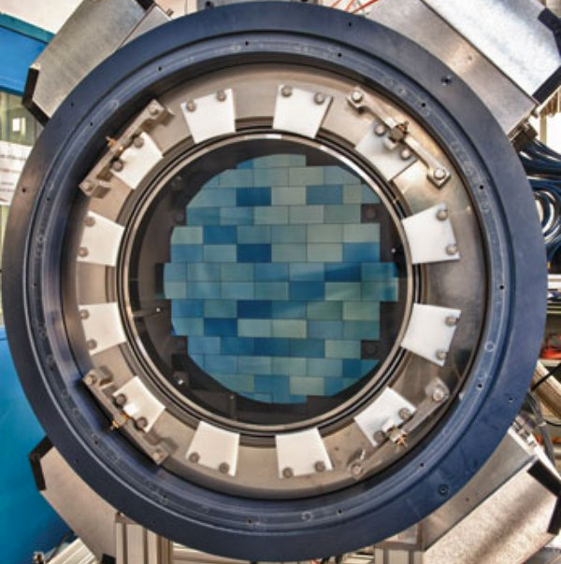
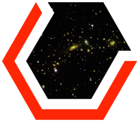
The Dark Energy Survey
Multi-component survey designed to probe dark energy and origin of cosmic acceleration
DES-Wide
5000 deg² in grizY: rAB ~ 24.3, iAB ~23.5 (10σ)
Large Scale Structure; Weak Lensing; Galaxy Cluster
DES-SN
~ 6-day cadenced griz survey over 27 deg²
Type Ia Supernovae
Probes of both Distance vs. Redshift & Growth of Structure
UK DES Collaboration Cambridge ❖ Edinburgh ❖ Nottingham ❖ Portsmouth ❖ Sussex ❖ UCL
Dark Energy Camera (DECam) on 4m Blanco Telescope at CTIO
520 Mpx camera; 3 deg² FoV; deep-depleted LBNL CCDs
Allocated 525 nights over 5 observing seasons (Aug - Feb, 2013 - 2018)
DESY4 starts 13 August 2016

Slide 9
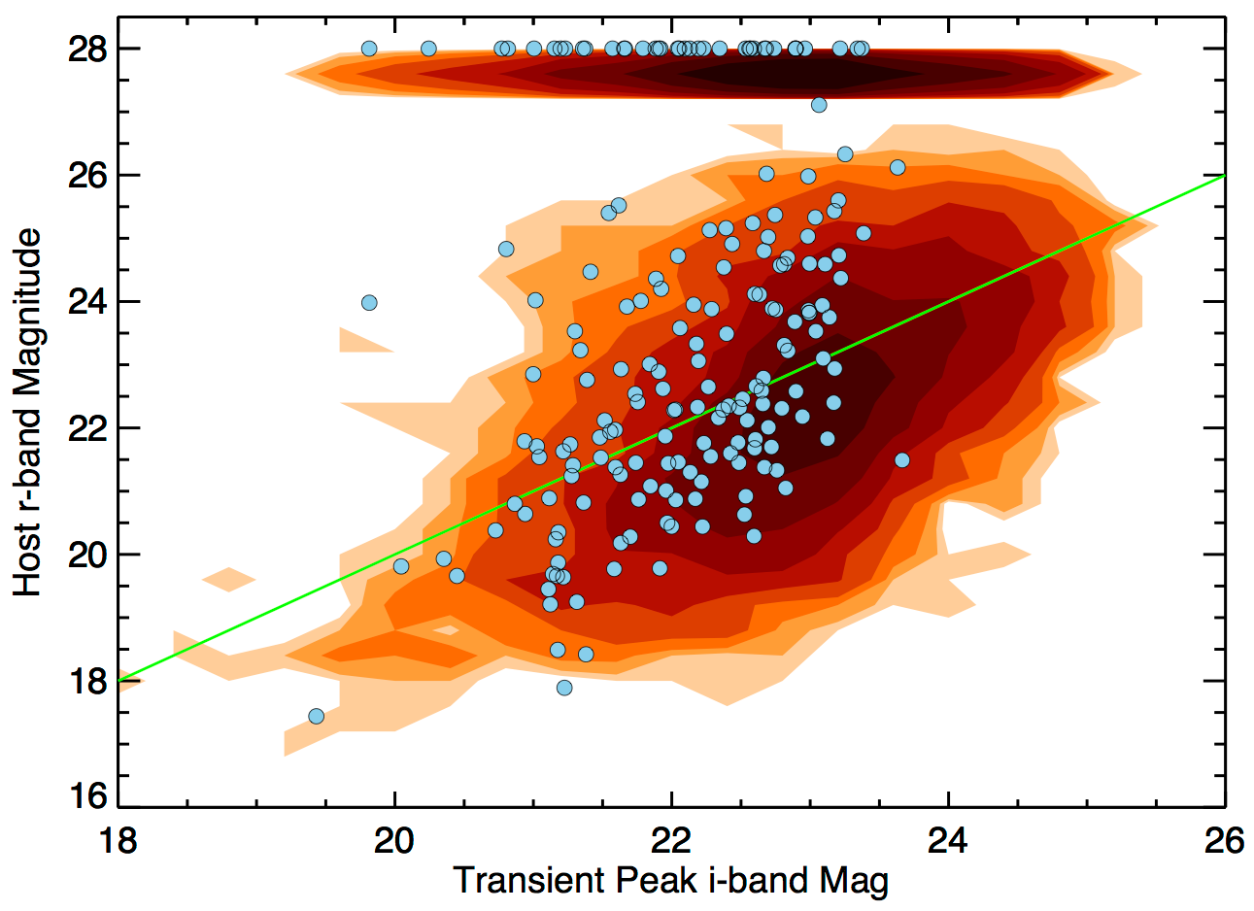
DES host/transient magnitude parameter space

Slide 10
DES-SN Spectroscopic Programs
After the fact
Thousands of events
Host-Galaxy Redshifts
Bright hosts
Photometric Classification
SNe in Faint Host Galaxies
Redshifts for faint hosts; unbiased sample
Representative sample
Tuned to cover parameter space expected from photometric-cosmology sample
Complete sample
Measure SN population demographics at low-z
Unbiased sample
Ancillary programs (SN Physics, weirdos)
Live
Hundreds of events

Slide 11
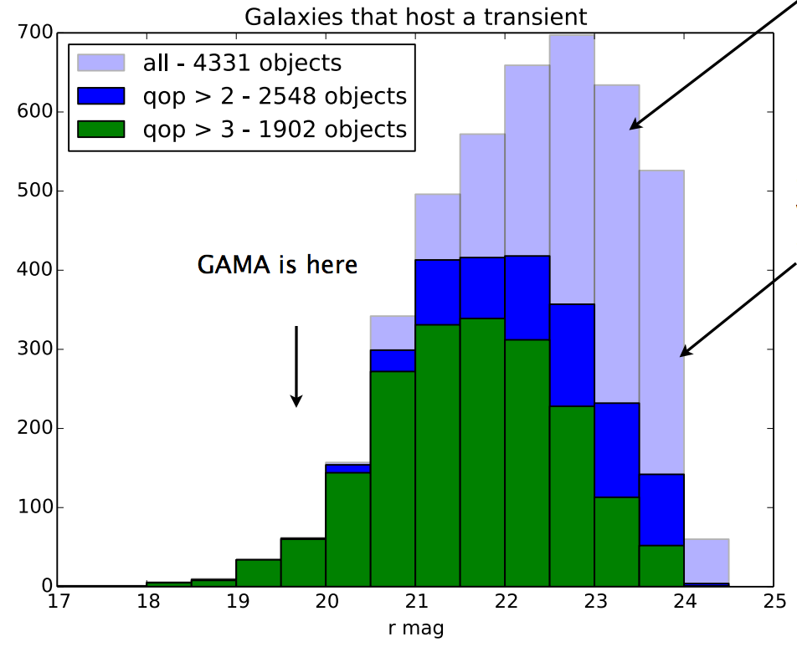
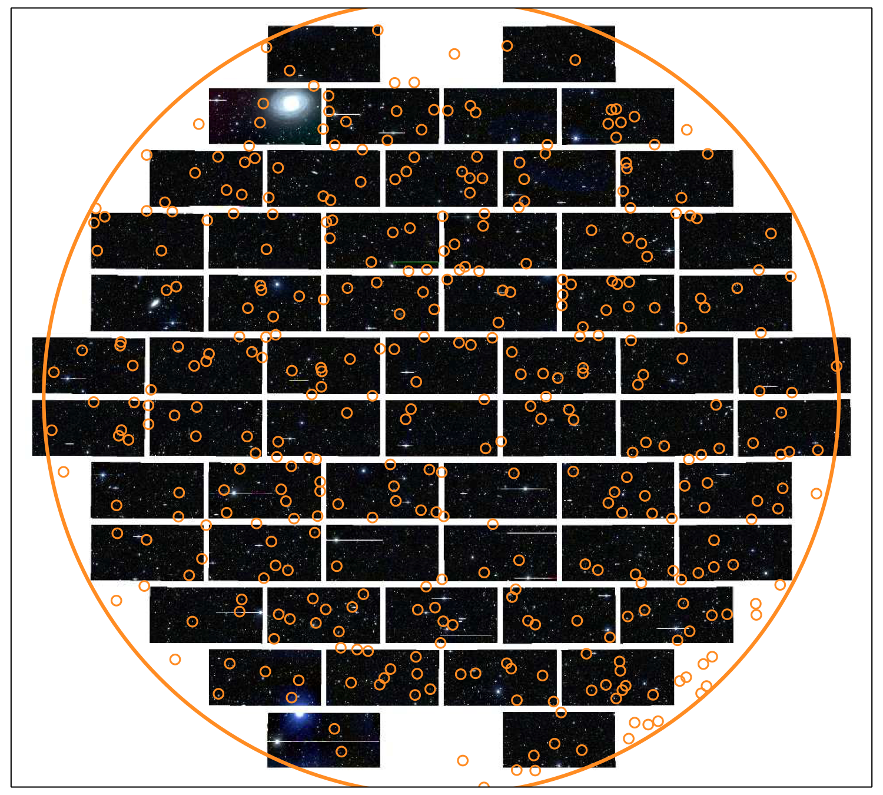
AAT: OzDES
100 night program over 5 years overlapping with DES
SN Hosts repeatedly targeted to build up depth; Live transients targeted as well
On target for ~4000 SN host redshifts
Before DESY3
Courtesy C. Lidman

Slide 12
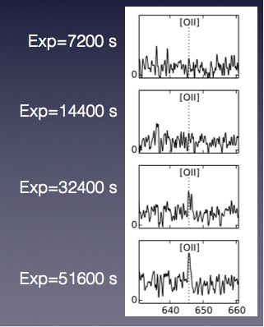
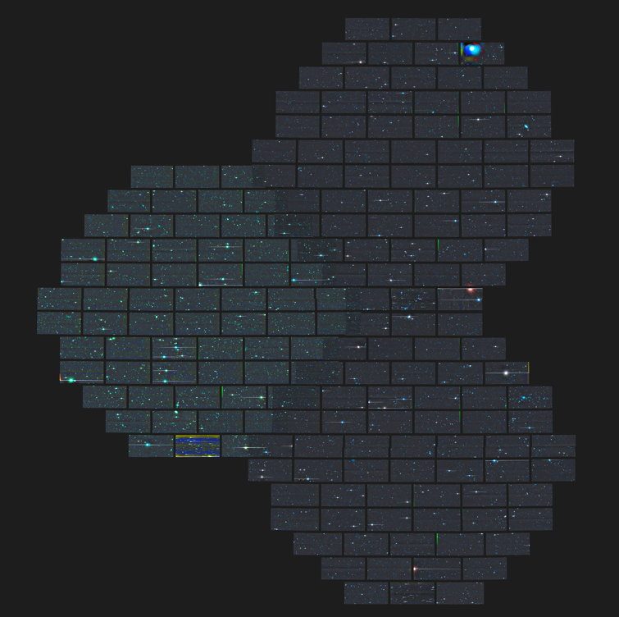
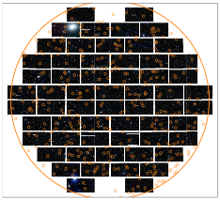
Large MOS follow-up of SN hosts
SN C Fields
C1
C3
C2

Slide 13
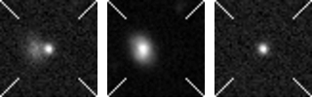
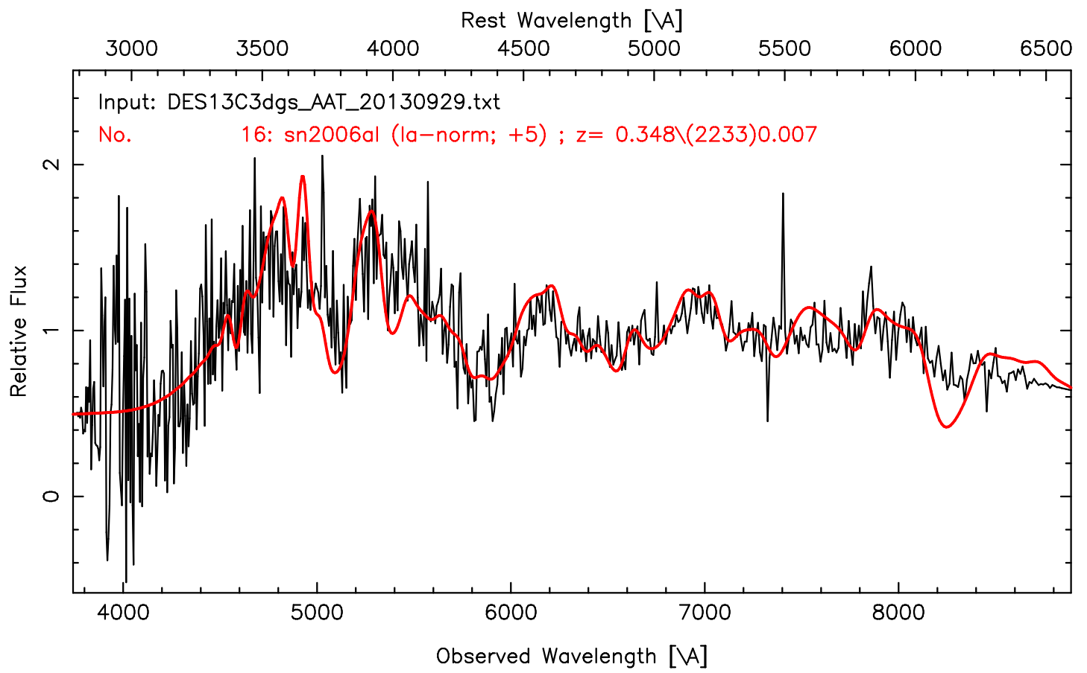
OzDES Live Sne!
20130909-r
Peak r=21.5
search template subtraction

Slide 14
DES Y1-3 spectroscopic sample
D’Andrea et al. 2017

Slide 15
4MOST: A multi-fibre spectrograph for the ESO VISTA telescope

Slide 18
4MOST / TiDES Survey
TIme Domain Extragalactic Survey (TiDES)
250,000 fibre hours over 5-years
Average 2.5% of fibres in any pointing
32 fibres/pointing x 8 pointings x 150 dark nights ~ 50,000 spectra/yr
Can be live transients or host galaxies
Scheduling 1-7 days in advance (TBD)
Envisage sensible overlap of 4MOST calibration fields and LSST Deep Drilling fields

Slide 19
TiDES broad strategy SN Ia host galaxies
Rationale: Wherever 4MOST points, LSST will have previously discovered SNe. Put a 4MOST fibre on the host galaxy to get a redshift.
How many fibres do we need for this?
Assumptions
On average LSST produces 0.5 SNeIa/yr/sq deg to z=0.5 that are suitable for cosmology (depends on light-curve quality). Large uncertainty!
LSST starts operation in 2021 (…)
4MOST starts operation in 2022
4MOST covers 18,000 deg², visiting each area of sky at least twice, in first 5 years
Each 4MOST visit is 1 hour (3 x 20 mins).
Each host must be observed twice to reach sufficient S/N
Notes:
Sep16: Currently LSST end of science verification is end of 2021. Then 1 year of schedule contingency

Slide 20
Rough numbers for LSST SN hosts
Year | New 4MOST area covered (sq deg) | Number of known LSST SNe hosts in that area
2022 | 4,000 | 4,000
2023 | 4,000 | 6,000
2024 | 4,000 | 8,000
2025 | 4,000 | 10,000
2026 | 4,000 | 12,000
Total | 20,000 | 40,000
We require 2hrs x 40,000 fibres = 80,000 fibre-hours
Final sample = 40,000 SNeIa
Note: LSST rate uncertainty !
Doesn’t include non-Ia hosts (contamination)
Doesn’t include LSST Deep drilling fields (or other TiDES science cases)

Slide 21
TiDES survey strategy: deeper observations
~10% of 4MOST sky visited more than twice because of overlaps between adjacent pointings
4MOST Deep fields build-up signal on faintest hosts and live SNe.
Dynamic scheduling – once sufficient signal-to-noise is obtained, move fibre to another source (cf. Similar to OzDES)
4MOST’s deep fields should coincide with those of LSST: higher redshift SNe with better LSST lightcurves

Slide 22
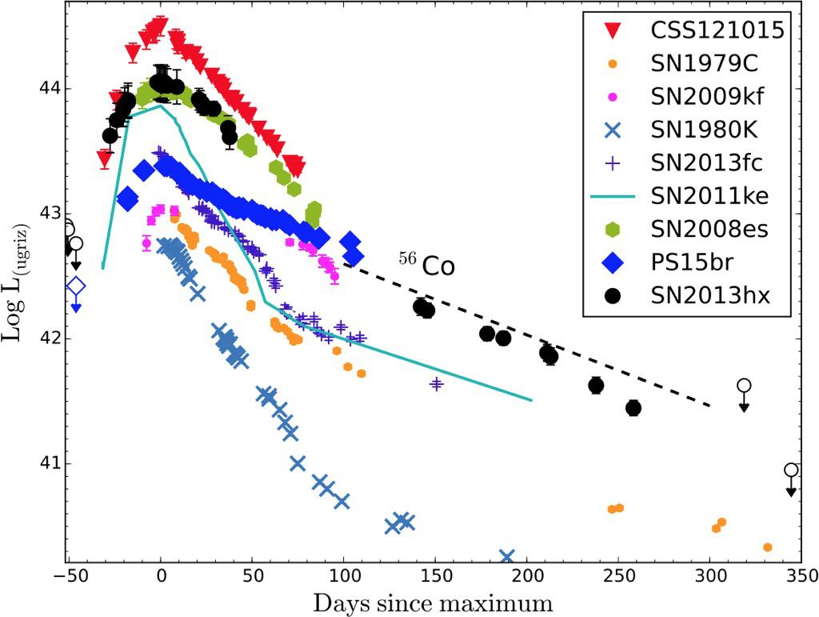
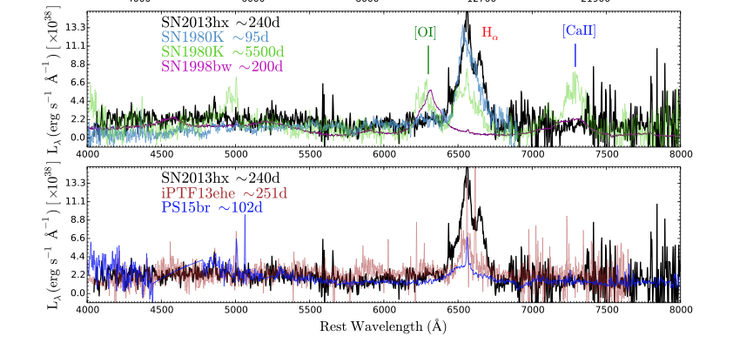
Live transients:science goals
Classification: Hostless SNe and training samples
R=22.5 AB == a normal SN Ia at z=0.5
Expect 3-4 live SNe per 4MOST pointing; 15000-20000 over 5 years
Screening: triggering follow-up on other facilities
Outliers: find rare events (e.g., very luminous events )
Rates, environments, correlations with host galaxy properties
Transient physics (from 4MOST and follow-up elsewhere)
SLSNe to z~2; possible standard candles for cosmology
Two Hydrogen-rich SLSNe, screened with PESSTO (2-4m telescopes) and followed with VLT. (Inserra et al 2016)

Slide 23
DES host/transient magnitude parameter space

